Slide 1

Data Warehouse Architecture
Pertemuan 2
Dr. Dedi Trisnawarman

Slide 2
Definition
“A Data Warehouse is a subject oriented, integrated, nonvolatile, and time variant collection of data in support of management’s decisions.” Bill Inmon (1996)

Slide 3
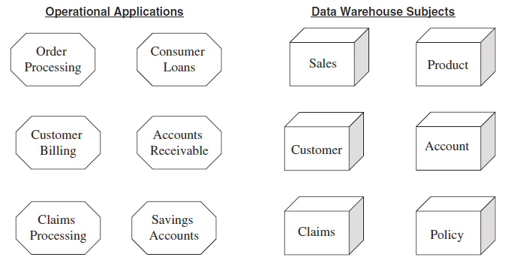
The Data Warehouse is Subject Oriented.

Slide 4
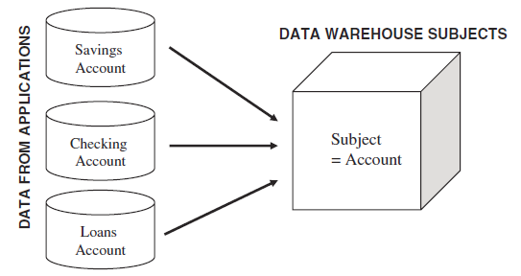
The Data Warehouse is Integrated
Before moving the data into the data warehouse, you have to go through a process of transformation, consolidation, and integration of the source data. Here are some of the items that would need to standardized and made consistent:
Naming conventions
Codes
Data attributes
Measurements

Slide 5
Time-Variant Data
The time-variant nature of the data in a data warehouse
Allows for analysis of the past
Relates information to the present
Enables forecasts for the future

Slide 6
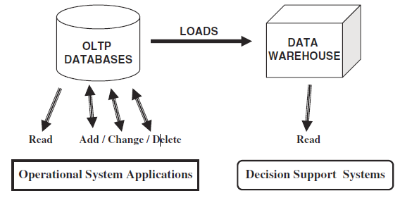
The Data Warehouse is Nonvolatile

Slide 7
Fundamental Questions
Top-down or bottom-up approach?
Enterprise-wide or departmental?
Which first—data warehouse or data mart?
Build pilot or go with a full-fledged implementation?
Dependent or independent data marts?

Slide 8
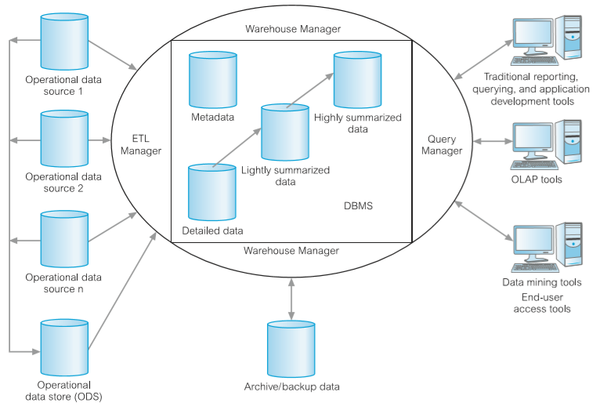
Data Warehouse architecture
Source :

Slide 9
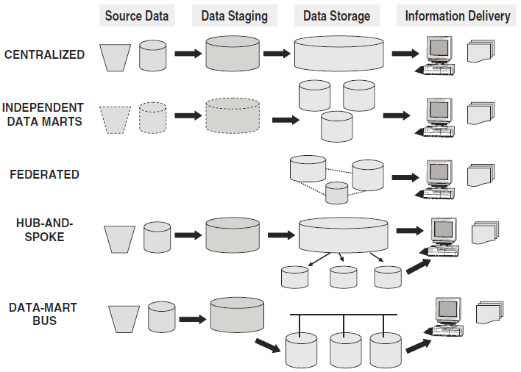
Data Warehouse Architectural Types

Slide 10
Centralized Data Warehouse
This architectural type takes into account the enterprise-level information requirements. An overall infrastructure is established. Atomic level normalized data at the lowest level of granularity is stored in the third normal form. Occasionally, some summarized data is included.
Queries and applications access the normalized data in the central data warehouse. There are no separate data marts.

Slide 11
Independent Data Marts
This architectural type evolves in companies where the organizational units develop their own data marts for their own specific purposes.
Although each data mart serves the particular organizational unit, these separate data marts do not provide “a single version of the truth.” The data marts are independent of one another.

Slide 12
Federated
Some companies get into data warehousing with an existing legacy of an assortment of decision-support structures in the form of operational systems, extracted datasets, primitive data marts, and so on.
For such companies, it may not be prudent to discard all that huge investment and start from scratch. The practical solution is a federated architectural type where data may be physically or logically integrated through shared key fields, overall global metadata, distributed queries, and such other methods.
In this architectural type, there is no one overall data warehouse.

Slide 13
Hub-and-Spoke
This is the Inmon Corporate Information Factory approach.
Similar to the centralized data warehouse architecture, here too is an overall enterprise-wide data warehouse. Atomic data in the third normal form is stored in the centralized data warehouse.
Most queries are directed to the dependent data marts although the centralized data warehouse may itself be used for querying. This architectural type results from adopting a top-down approach to data warehouse development.

Slide 14
Data-Mart Bus
This is the Kimbal conformed supermarts approach.
The principal notion is that by conforming dimensions among the various data marts, the result would be logically integrated supermarts that will provide an enterprise view of the data.
The data marts contain atomic data organized as a dimensional data model.
This architectural type results from adopting an enhanced bottom-up approach to datawarehouse development.

Slide 15
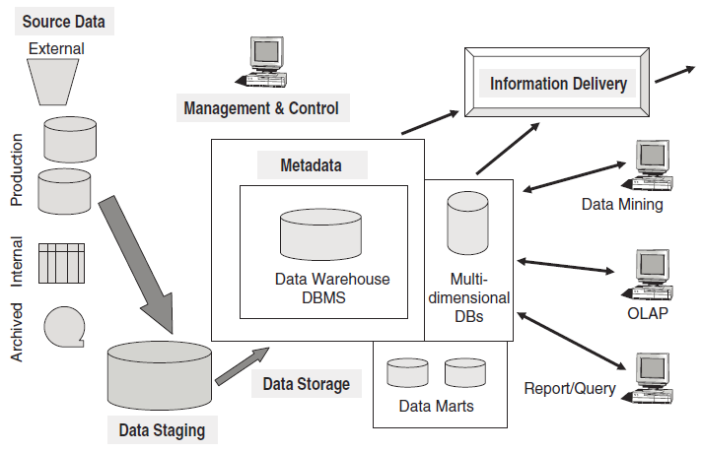
Overview of The Components

Slide 16
Data warehouse tools
Data extraction : gathering data from multiple heterogeneous sources.
Data cleaning : cleaning or correcting data error
Data transformation : converting data to DW format
Data loading : sorting, summarizing, consolidating, checking integrity, and building indices and partitions.
Data refresher : updating data

Slide 17
Data mart
A database that contains a subset of corporate data to support the analytical requirements of a particular business unit
Reason to use data mart
Improve response time
Cost efficiency
Security reason
Specified access user

Slide 18
Datawarehouse Design

Slide 19
Methodology
Inmon
Kimball
Create data model for all
Then, used for feed data marts
Advantages:
Provide consistent and comprehensive view
Disadvantage :
Hard to be implemented on complex project
Start by identifying information requirement ( data marts )
Advantage:
Easy to handle complex project within allocated period and budget
Disadvantage :
May not provide consistent and comprehensive database

Slide 20
Top-Down Approach
Top-Down Approach Bill Inmon is one of the leading proponents of the top-down approach. He has defined a data warehouse as a centralized repository for the entire enterprise.
In this approach the data in the data warehouse is stored at the lowest level of granularity based on a normalized data model. In the Inmon vision the data warehouse is at the center of the “Corporate Information Factory” (CIF) providing the logical framework for delivering business intelligence to the enterprise. Business operations provide data to drive the CIF. The centralized data warehouse would feed the dependent data marts that may be designed based on a dimensional data model.

Slide 21
Top-Down Approach
The advantages of this approach are:
A truly corporate effort, an enterprise view of data
Inherently architected, not a union of disparate data marts
Single, central storage of data about the content
Centralized rules and control
May see quick results if implemented with iterations
The disadvantages are:
Takes longer to build even with an iterative method
High exposure to risk of failure
Needs high level of cross-functional skills
High outlay without proof of concept

Slide 22
Bottom-Up Approach
Bottom-Up Approach Ralph Kimball, another leading author and expert practitioner in data warehousing, is a proponent of the approach that has come to be known as the bottom-up approach. Kimball (1996) envisions the corporate data warehouse as a collection of conformed data marts. The key consideration is the conforming of the dimensions among the separate data marts. In this approach data marts are created first to provide analytical and reporting capabilities for specific business subjects based on the dimensional data model.

Slide 23
Bottom-Up Approach
The advantages of this approach are:
Faster and easier implementation of manageable pieces
Favorable return on investment and proof of concept
Less risk of failure
Inherently incremental; can schedule important data marts first
Allows project team to learn and grow
The disadvantages are:
Each data mart has its own narrow view of data
Permeates redundant data in every data mart
Perpetuates inconsistent and irreconcilable data
Proliferates unmanageable interfaces

Slide 24
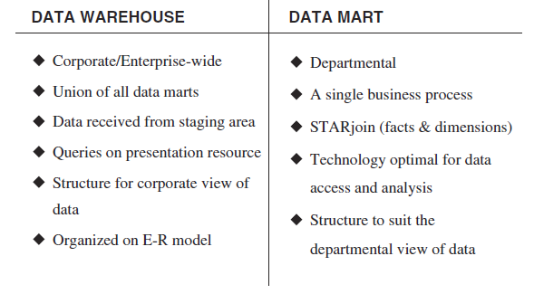
Data Warehouse versus Data Mart

Slide 25
Phase I Create a High-Level Dimensional Model
Modelling stage by kimball
Select Business Process
Declare Grain
Choose Dimensions
Identify Facts
Phase II Identify All Dimension Attributes for the Dimensional Model

Slide 26
Online analytical processing (OLAP)

Slide 27
OLAP is The dynamic synthesis, analysis, and consolidation of large volumes of multidimensional data.
Abilities to answer “Why ?”

Slide 28
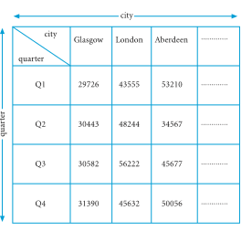
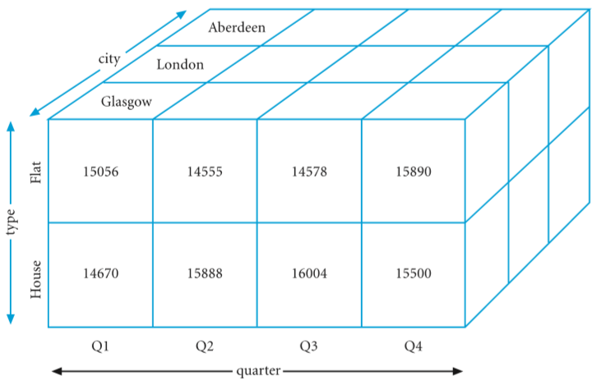
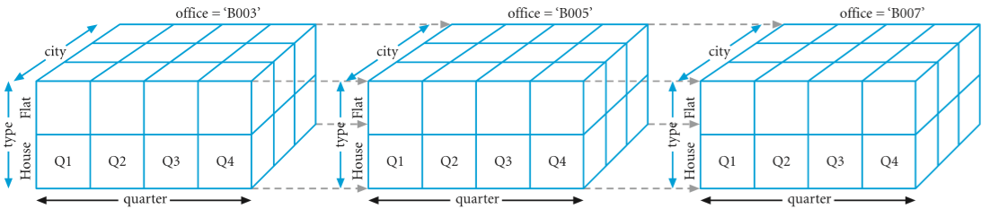
Multidimension data
Two-dimensional matrix
Three-dimensional matrix
Four-dimensional matrix

Slide 29
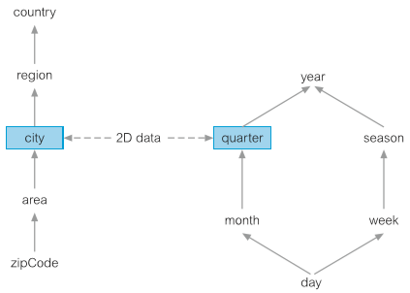
Dimensional Hierarchy
Mappings from a set of lower-level concepts to higher-level concepts.
Example : city-> province -> country

Slide 30
OLAP Server
Relational OLAP | Multidimensional OLAP
Process is fast | Process is slow
Use array to store data | Use relational table
Easy to use | Little tricky
Separate database | May not require
Relational OLAP
Multidimensional OLAP
Hybrid OLAP

Slide 31
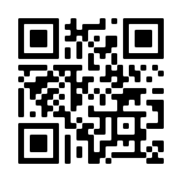
Schema
Star schema
Snowflake schema
Fact Constellation schema
#Baca www.tutorialspoint.com/dwh/dwh_schemas

Slide 32
Codd’s Rules for OLAP Tools
Codd formulated twelve rules as the basis for selecting OLAP tools:
Multidimensional conceptual view
Transparency
Accessibility
Consistent reporting performance
Client–server architecture
Generic dimensionality
Flexible reporting
Generic dimensionality
Dynamic sparse matrix handling
Multi-user support
Unrestricted cross-dimensional operations
Intuitive data manipulation
Unlimited dimensions and aggregation levels

Slide 33
Data Mining

Slide 34
The process of extracting valid, previously unknown, comprehensible, and actionable information from large databases and using it to make crucial business decisions

Slide 35
Data mining Technique
Predictive analysis
Database segmentation
Link analysis
Deviation detection

Slide 36
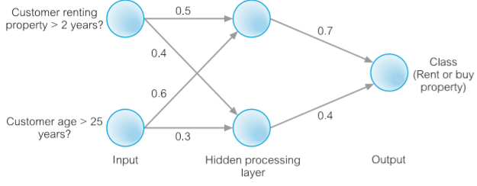
Predictive Modeling
Use supervised learning approach to forecast/predict outcome
Classification
establish a specific predetermined class for each record in a database
Value prediction
estimate a continuous numeric value that is associated with a database record

Slide 37
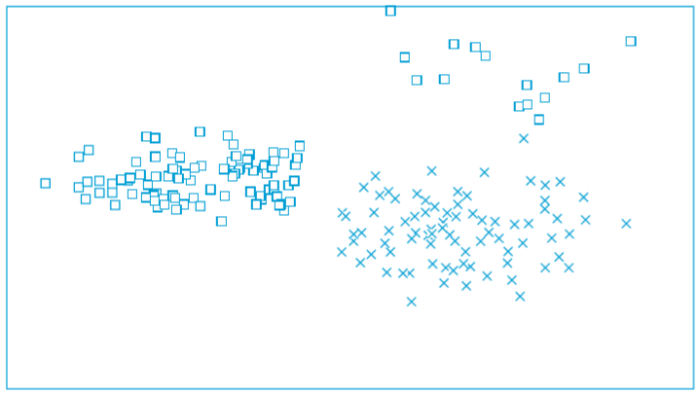
Database segmentation
Aim to clusters or categorized data by similar value

Slide 38
Link analysis
Evaluate the relationship or connection between network nodes

Slide 39
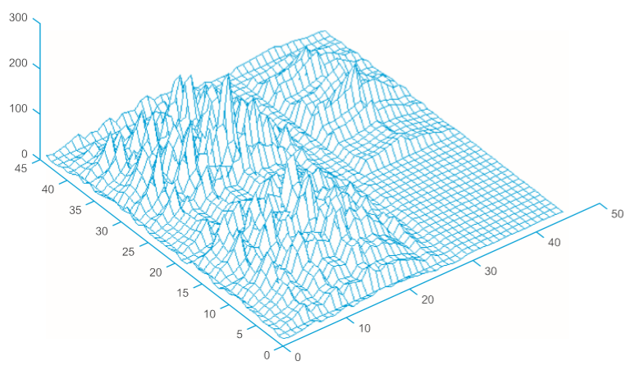
Deviation detection
Identifies outliner or anomaly
This graphic visualize 3d model of previous graphic (database segmentation)

Slide 40
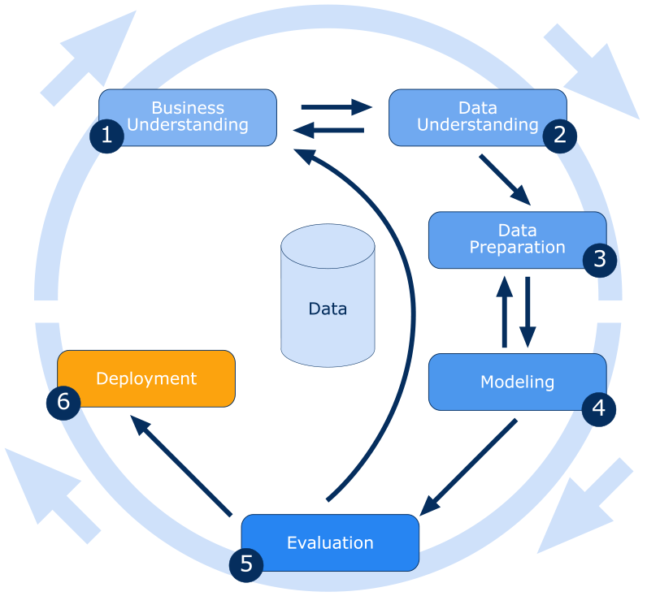
Data mining process
Cross-industry standard process for data mining ( CRISP-DM ) is an open standard process model that describes common approaches used by data mining experts.
Six major phase
Business understanding
Data understanding
Data preparation
Evaluation
Deployment
Source : https://barnraisersllc.com

Slide 41
Data mining tools
Data preparation
Data mining algorithms
Scalability and performance
Good Dashboard

Slide 42
Data Warehouse
A data warehouse is a computer system dedicated to storing and analyzing data to reveal trends, patterns, and correlations that provide information and insight. Traditionally, organizations have used data warehouses to store and integrate data collected from their internal sources (usually transactional databases), including marketing, sales, production, and finance. The data warehouse emerged when companies realized that analyzing data directly from those internal systems competed with the day-to-day activities of business users such as data entry and operational reporting.
Over the years, data sources have expanded beyond internal business operations and external transactions. They now include exponentially greater volumes of data and more complex data from websites, mobile phones, online games, online banking apps, and even machines. Most recently, companies are capturing huge amounts of data from IoT (Internet of things)-enabled devices.

Slide 43
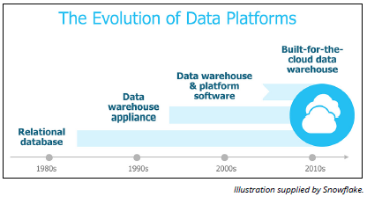
The Evolution of Data Warehousing

Slide 44
Recognizing the limitations of conventional data warehousing
Conventional data warehouse solutions were not designed to handle the volume, variety, and complexity of today’s data. And newer systems designed to address these shortcomings struggle to accommodate the data access and analysis that organizations now require. Today’s challenges reveal:
Data sources are more numerous and varied, resulting in more diverse data structures that must co-exist in a single location to enable exhaustive and affordable analysis.
Traditional architectures inherently cause competition between users and data integration activities, making it difficult to simultaneously pipe new data into the data warehouse and provide users with adequate performance.
Scaling up a conventional data warehouse to meet today’s increasing storage and workload demands, when possible, is expensive, painful, and slow.
The more recent, alternative data platforms are often complex, requiring specialized skills and lots of tuning and configuration. This struggle worsens when trying to handle the growing number and diversity of data sources, users, and queries.

Slide 45
Technology and design to the rescue!
The cloud:
A key factor driving the evolution of the modern data warehouse is the cloud. This creates access to nearinfinite, low-cost storage; improved scalability; the outsourcing of data warehousing management and security to the cloud vendor; and the potential to pay for only the storage and computing resources actually used.

Slide 46
Technology and design to the rescue!
Massively parallel processing (MPP):
MPP emerged in the previous decade, which involves dividing a single computing operation to execute simultaneously across a large number of separate computer processors. This division of labor facilitates faster storage and analysis of data when software is built to capitalize on this approach.

Slide 47
Technology and design to the rescue!
Columnar storage:
Traditionally, databases stored records in rows, similar to how a spreadsheet appears.
For example, this could include all information about a customer or a retail transaction. Retrieving data the traditional way required the system to read the entire row to get one element. This is laborious and time-consuming.
With columnar storage, each data element of a record is stored in a column. With this approach, a user can query just one data element, such as gym members who have paid their dues, without having to read everything else in that entire record, which may include each member’s ID number, name, age, address, city, state, payment info, and so on.
The approach can provide a much faster response to these kinds of analytic queries.

Slide 48
Technology and design to the rescue!
Vectorized processing:
This form of data processing for data analytics (the science of examining data to draw conclusions) takes advantage of the recent and revolutionary computer chip designs.
This approach delivers much faster performance versus older data warehouse solutions built decades ago for older, slower hardware technology.

Slide 49
Technology and design to the rescue!
Solid state drives (SSDs):
Unlike hard disk drives (HDDs), SSDs store data on flash memory chips, which accelerates data storage, retrieval, and analysis.
A solution that takes advantage of SSDs can deliver significantly better performance.

Slide 50
Introducing the cloud data warehouse
Cloud data warehousing is a cost-effective way for companies to take advantage of the latest technology and architecture without the huge upfront cost to purchase, install, and configure the required hardware, software, and infrastructure.
The various cloud data warehousing options are generally grouped into the following three categories:
Traditional data warehouse software deployed on cloud infrastructure
Traditional data warehouse hosted and managed in the cloud by a third party as a managed service
A true SaaS data warehouse

Slide 51
Traditional data warehouse software deployed on cloud infrastructure:
This option is very similar to a conventional data warehouse, as it reuses the original code base. So you still need IT expertise to build and manage the data warehouse.
While you do not have to purchase and install the hardware and software, you may still have to do significant configuration and tuning, and perform operations such as regular backups.

Slide 52
Traditional data warehouse hosted and managed in the cloud by a third party as a managed service:
With this option, the third party provider supplies the IT expertise, but you’re still likely to experience many of the same limitations of a conventional data warehouse. The data warehouse is hosted on hardware installed in a data center managed by the vendor.
This is similar to what the industry referred to as an ASP or application service provider. The customer still has to specify in advance how much disk space and compute resources (CPUs and memory) they expect to use.

Slide 53
A true SaaS data warehouse:
With this option, often referred to as data-warehousing-as-a-service, (DWaaS), the vendor delivers a complete cloud data warehouse solution that includes all hardware and software and the IT and database administration (DBA) expertise required. Clients typically pay only for the storage and computing resources they use, when they use them. This option should scale up and down on demand.

Slide 54
Why You Need a Cloud Data Warehouse
Any organization that depends on data to better serve their customers, streamline their operations, and lead their industry will benefit from a cloud data warehouse. Unlike massive, traditional data warehouses, the cloud means businesses big and small can size their data warehouse to meet their needs and their budget, and dynamically grow and contract their system as things change from day-to-day and year-to-year.

Slide 55
Why You Need a Cloud Data Warehouse
Customer experience: Monitoring end-user behavior can help companies tailor products, services, and special offers to the needs and demands of individual consumers. With customer sentiment analysis, companies understand better what customers think by analyzing their social media postings, tweets, and other online messaging.
Quality assurance: Companies can also use the analysis of customer sentiment to monitor for early warning signs of customer service issues or product shortcomings and take action sooner than was previously possible when the only data source was call center complaint logs.
Operational efficiency: Operational intelligence (OI) consists of monitoring business processes and analyzing events to identify where a company can reduce costs, boost margins, streamline processes, respond to market forces more rapidly, and so on.
Innovation: Instead of only checking the rearview mirror to understand an industry’s recent past, companies can use new sources of data to spot and capitalize on trends, thereby disrupting their industry before an unknown or unforeseen competitor does so first.

